Slide 1
What is R?
TOG January Workshop 2022
Divya Anantsri

Slide 2
Trainee ‘Omics Group
Website: www.bcchr.ca/tog
Slack channel: togorg.slack.com
Mailing list: email sympa@list.bcchr.ca with the subject:
subscribe trainee omics_group yourFirstName yourLastName
Notes:
Add relevant links here for TOG

Slide 3
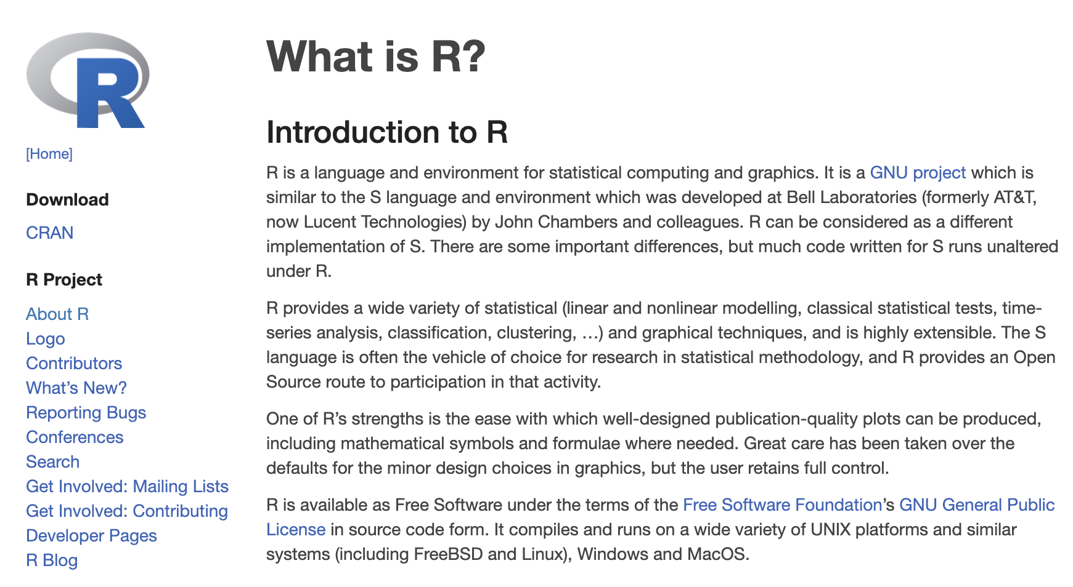
R is a statistical programming language
Why use R?
Open-source
Powerful
Advanced statistical tools
Superior graphics
Learn more at
R project
Notes:
R is open source which means it is free, it is accessible by everyone and it is managed by a community of users and developers and it is constantly updated. It is also much more powerful and it allows for better data visualization as you will see later on

Slide 4
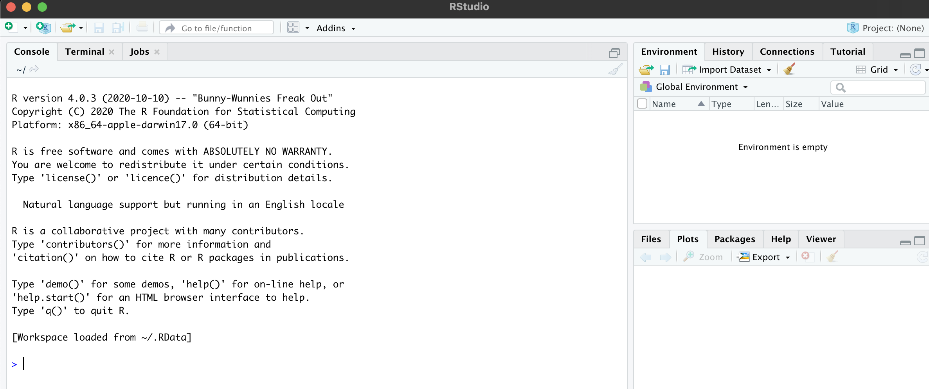
What is RStudio?
It is an integrated development environment (IDE) for R
Graphical interface, more user-friendly
Notes:
It is a software that was developed to make it easy for to work with R in a convenient way. It makes writing code, managing the different intermediary outputs, and plotting very easy. It is challenging to work efficiently with R (terminal) without R studio. Most people prefer to use R studio

Slide 5
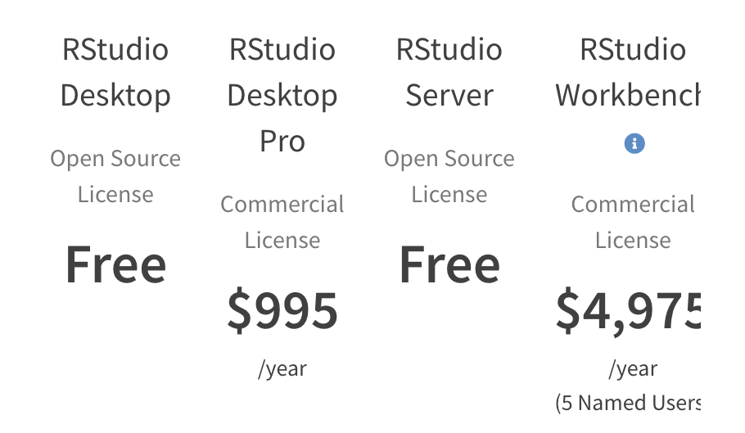
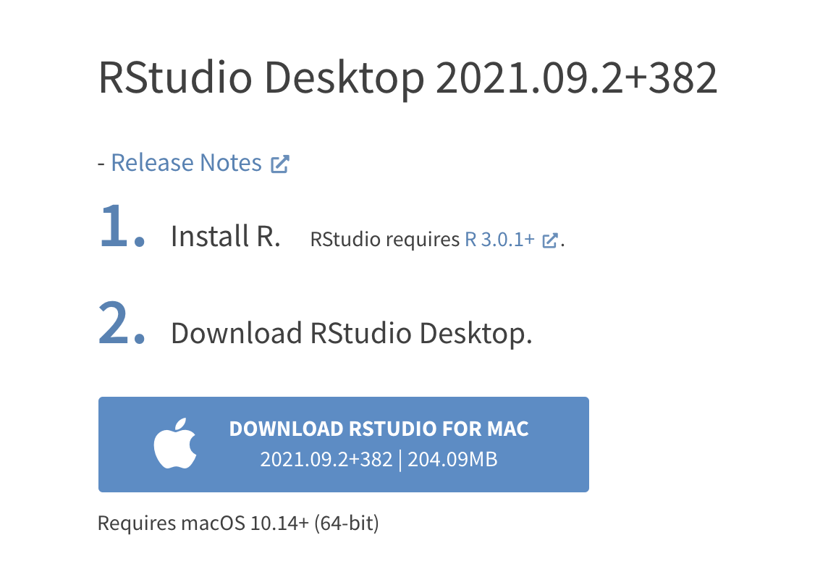
Installing R studio
https://www.rstudio.com/products/rstudio/download/#download
Today we will be working with the desktop version
(R studio server – opens in a web browser and can connect to computational resources form a high-performance cluster)
Notes:
Depending on you operating system – MAC or PC you will be prompted at the next page for installing R studio – if you are on a Mac it would be a .dmg file that you down and then you just run the installer, specify the location and

Slide 6
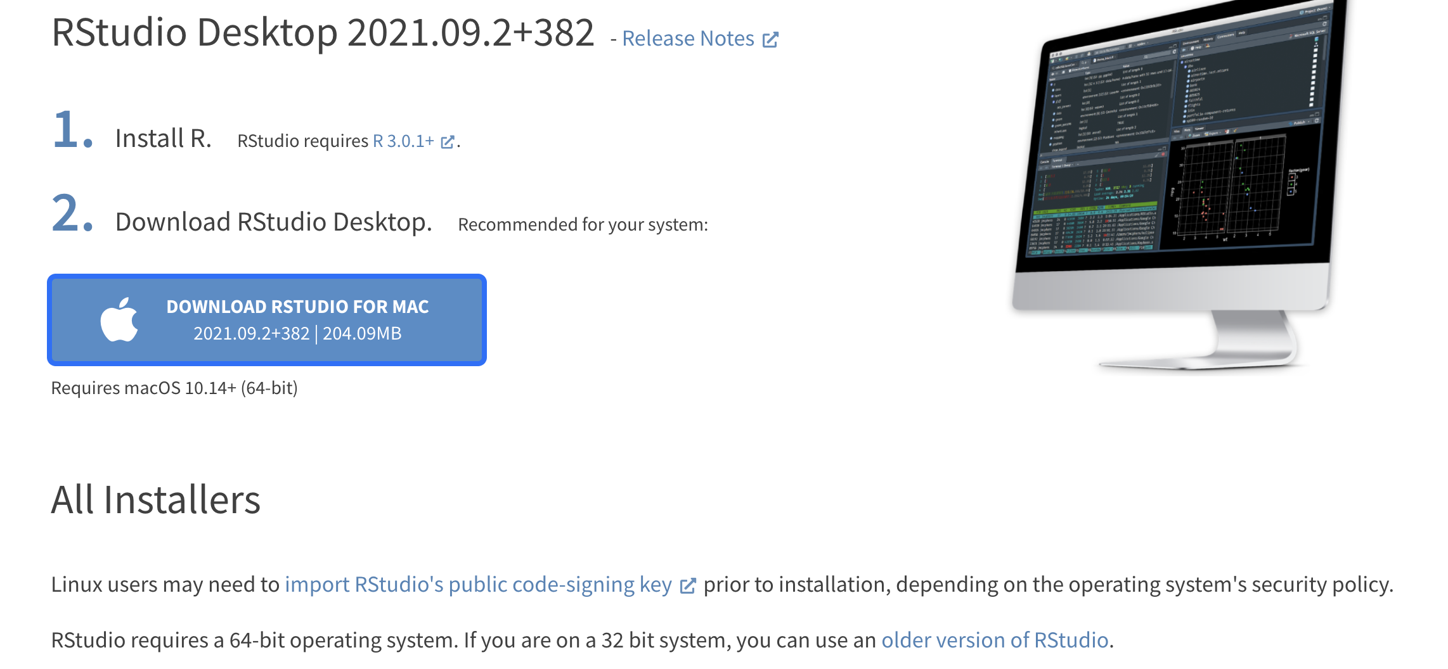
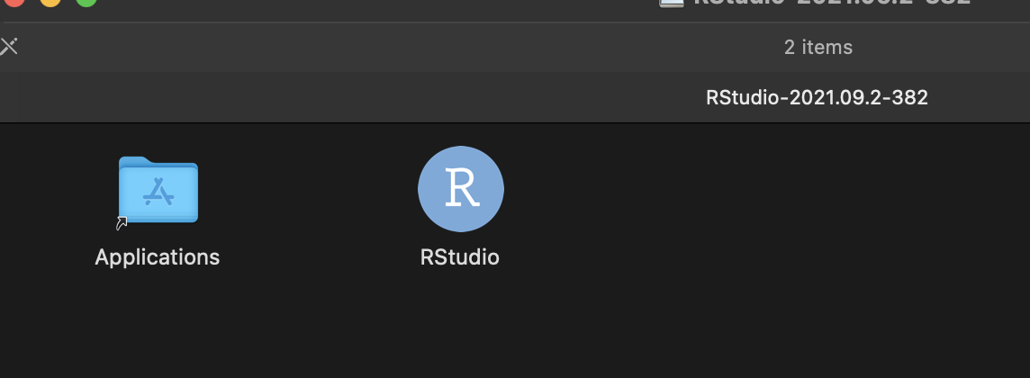
Installing R studio
https://www.rstudio.com/products/rstudio/download/#download
Notes:
Depending on you operating system – MAC or PC you will be prompted at the next page for installing R studio – if you are on a Mac it would be a .dmg file that you down and then you just run the installer, specify the location and

Slide 7
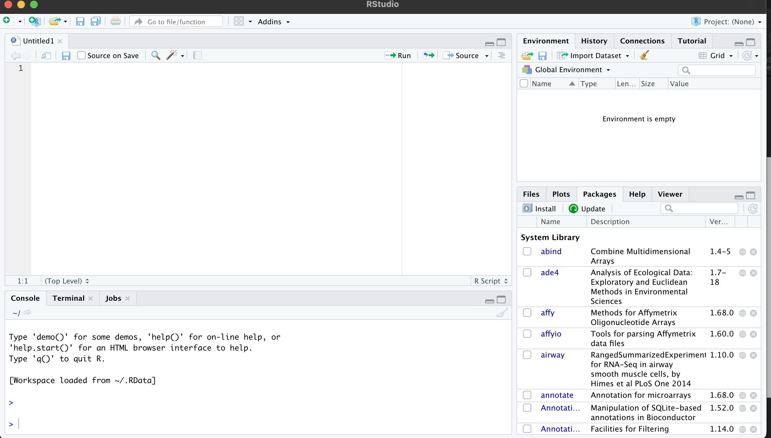
R studio is an IDE for running R code
R studio has four main panes
Source editor pane
Console pane
Plots/navigation/help/packages pane
Environment and History pane
Notes:
When you open R studio what you would see four panes – you might have to click on console o

Slide 8
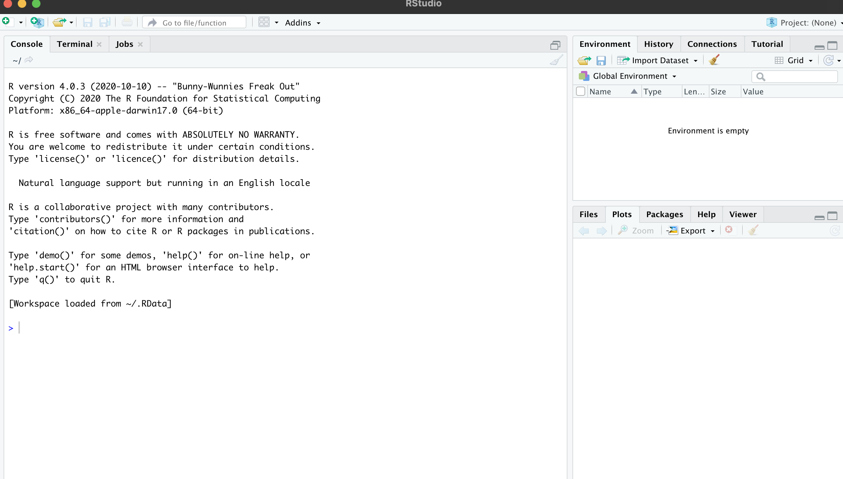
R studio is an IDE for running R code
click here to open the editor pane
Notes:
When you open R studio what you would see four panes – you might have to click on this icon to open up the editor pane

Slide 9
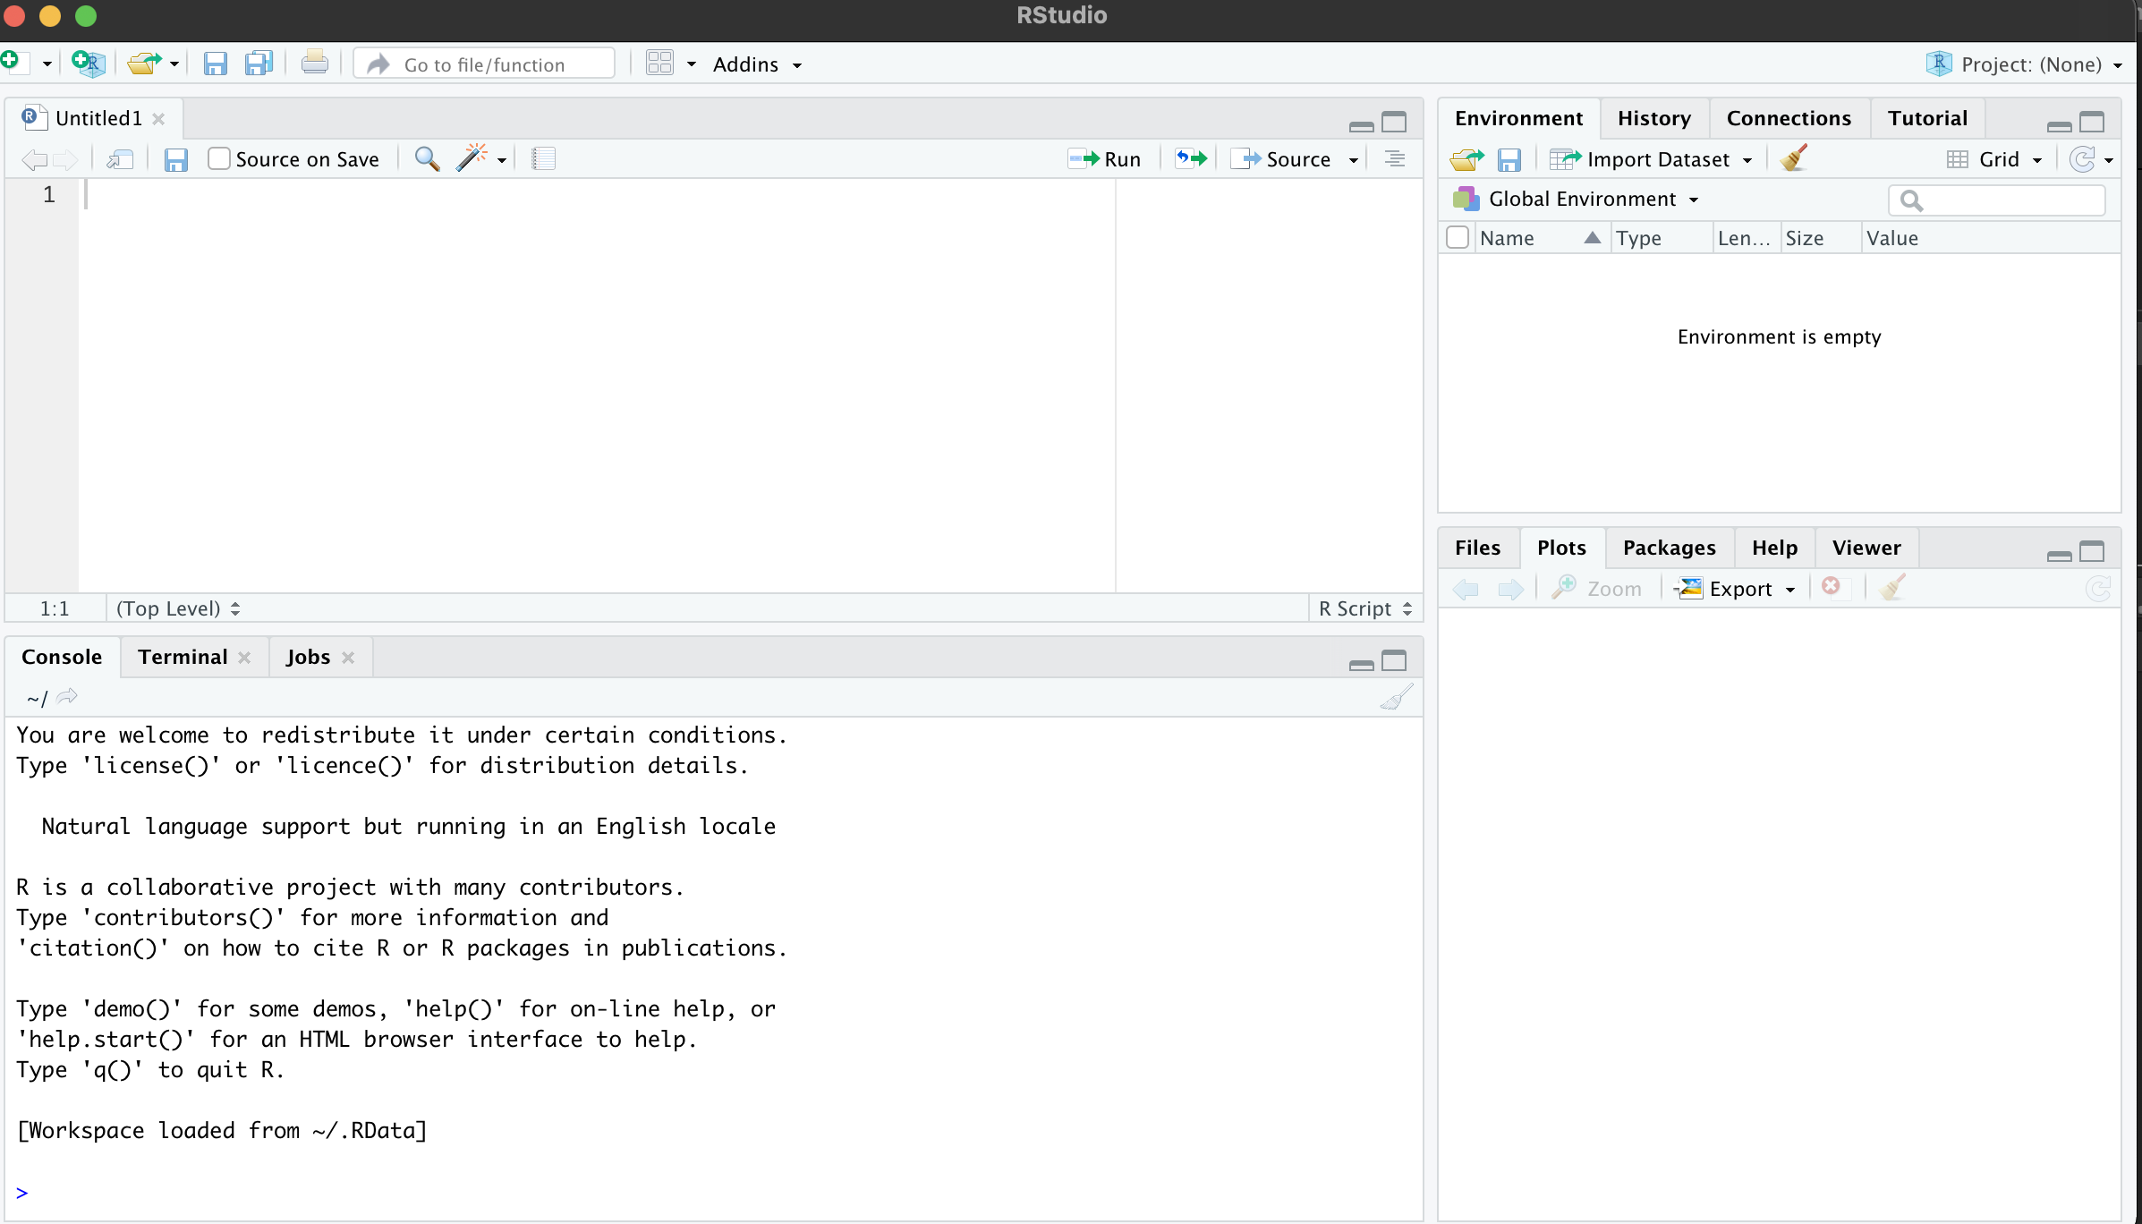
R studio is an IDE for running R code
1) Source or editor pane
3) Environment and history pane
2) Console pane
4) Navigation and plots pane
Notes:
This is what you would see with all the 4 panes open
The default option is an R script and I will talk about other file formats in a bit
Source or editor pane – this is where we would write our scripts – it is the text editor

Slide 10
R studio is an IDE for running R code
3) Environment and history pane
Objects and files show up here
Source or editor pane
We write our scripts here
4) Navigation and plots pane
2) Console pane
Results are displayed here
(Can also run commands in the console)
Notes:
This is what you would see with all the 4 panes open
The broom option is used to clear the space
The default option is an R script and I will talk about other file formats in a bit
Source or editor pane – this is where we would write our scripts – it is the text editor
Navigation Pane (bottom right) This pane has multiple functions:
Files: Navigate to files saved on your computer and in your working directory
Plots: View plots (e.g. charts and graphs) you have created
Packages: view add-on packages you have installed, or install new packages
Help: Read help pages for R functions
Viewer: View local web content

Slide 11
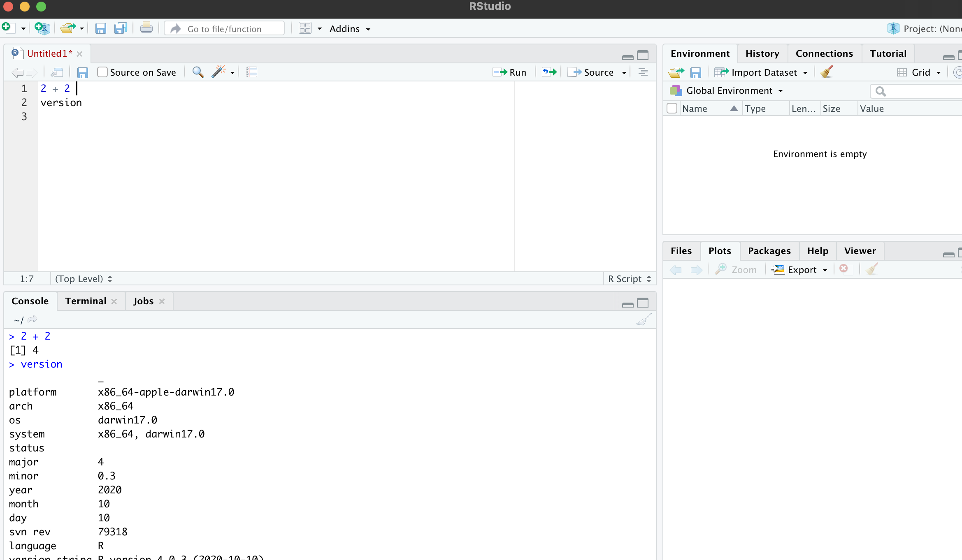
Executing commands in R studio
Executing commands
Use command/control + enter
Select the line and click Run/ cmd + enter to execute a single line in multiple lines of code
Use tab for autocompletion
Notes:
There are a couple of shortcuts to execute commands in the editor and the console
In the editor simply hitting enter at the end of the line would just take you to the next line whereas command (in mac) or control (PC) + enter will run that particular line of code. This is my preferred way. You could also use the run function here to do the same thing
When you have multiple lines of code and want to run a single line then you can select or highlight that particular line and execute using one of these ^ two ways
In the console, however just hitting enter would work I think there might be ways to configure keyboard shortcuts but I am not sure about those

Slide 12
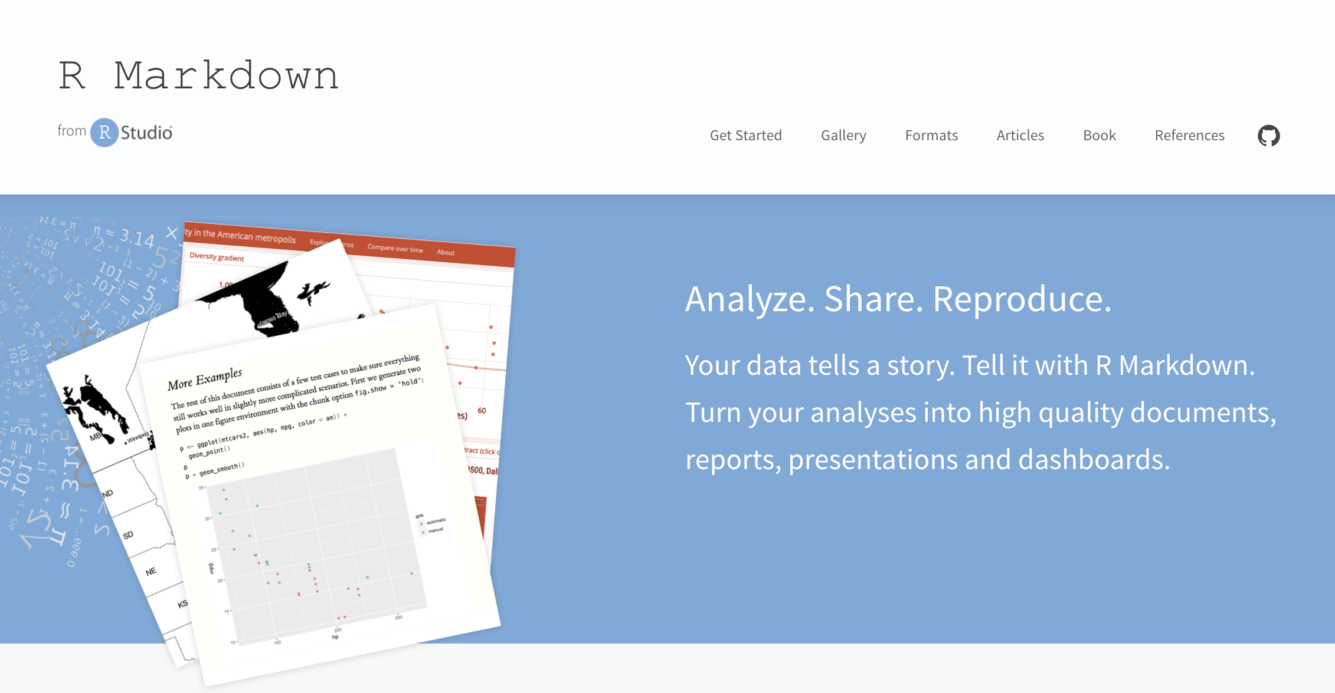
R markdown
Write code and comments in R markdown and generate an R markdown document (RMD) - for sharing and presenting
Notes:
By default what opens up is an R script. It is a lot more convenient to work in a R markdown.

Slide 13
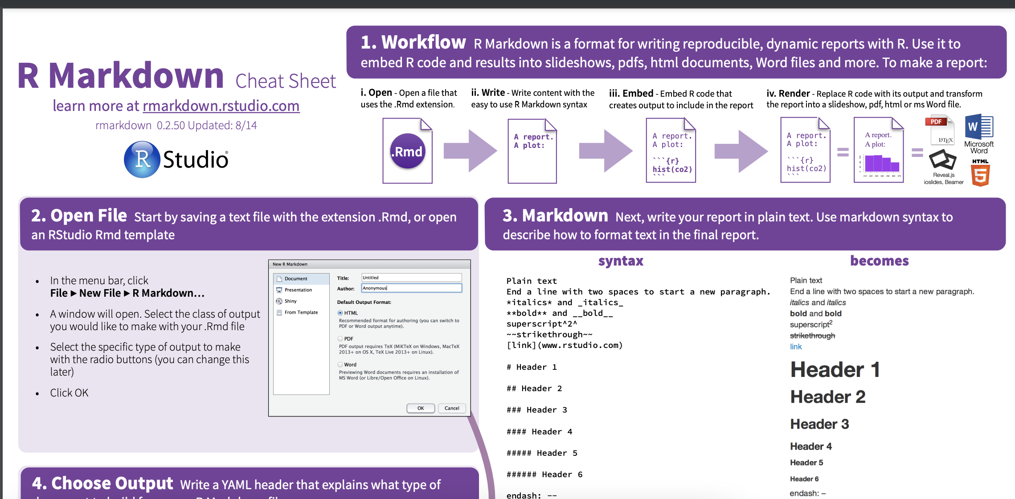
R markdown cheat sheet
https://www.rstudio.com/wp-content/uploads/2015/02/rmarkdown-cheatsheet.pdf
Notes:
Markdown language is what is used in plain text which means it is unlike MS word or google which use the rich text format
So you would have to use a specific syntax for your headings, italics and bold. This cheatsheet is very handy

Slide 14
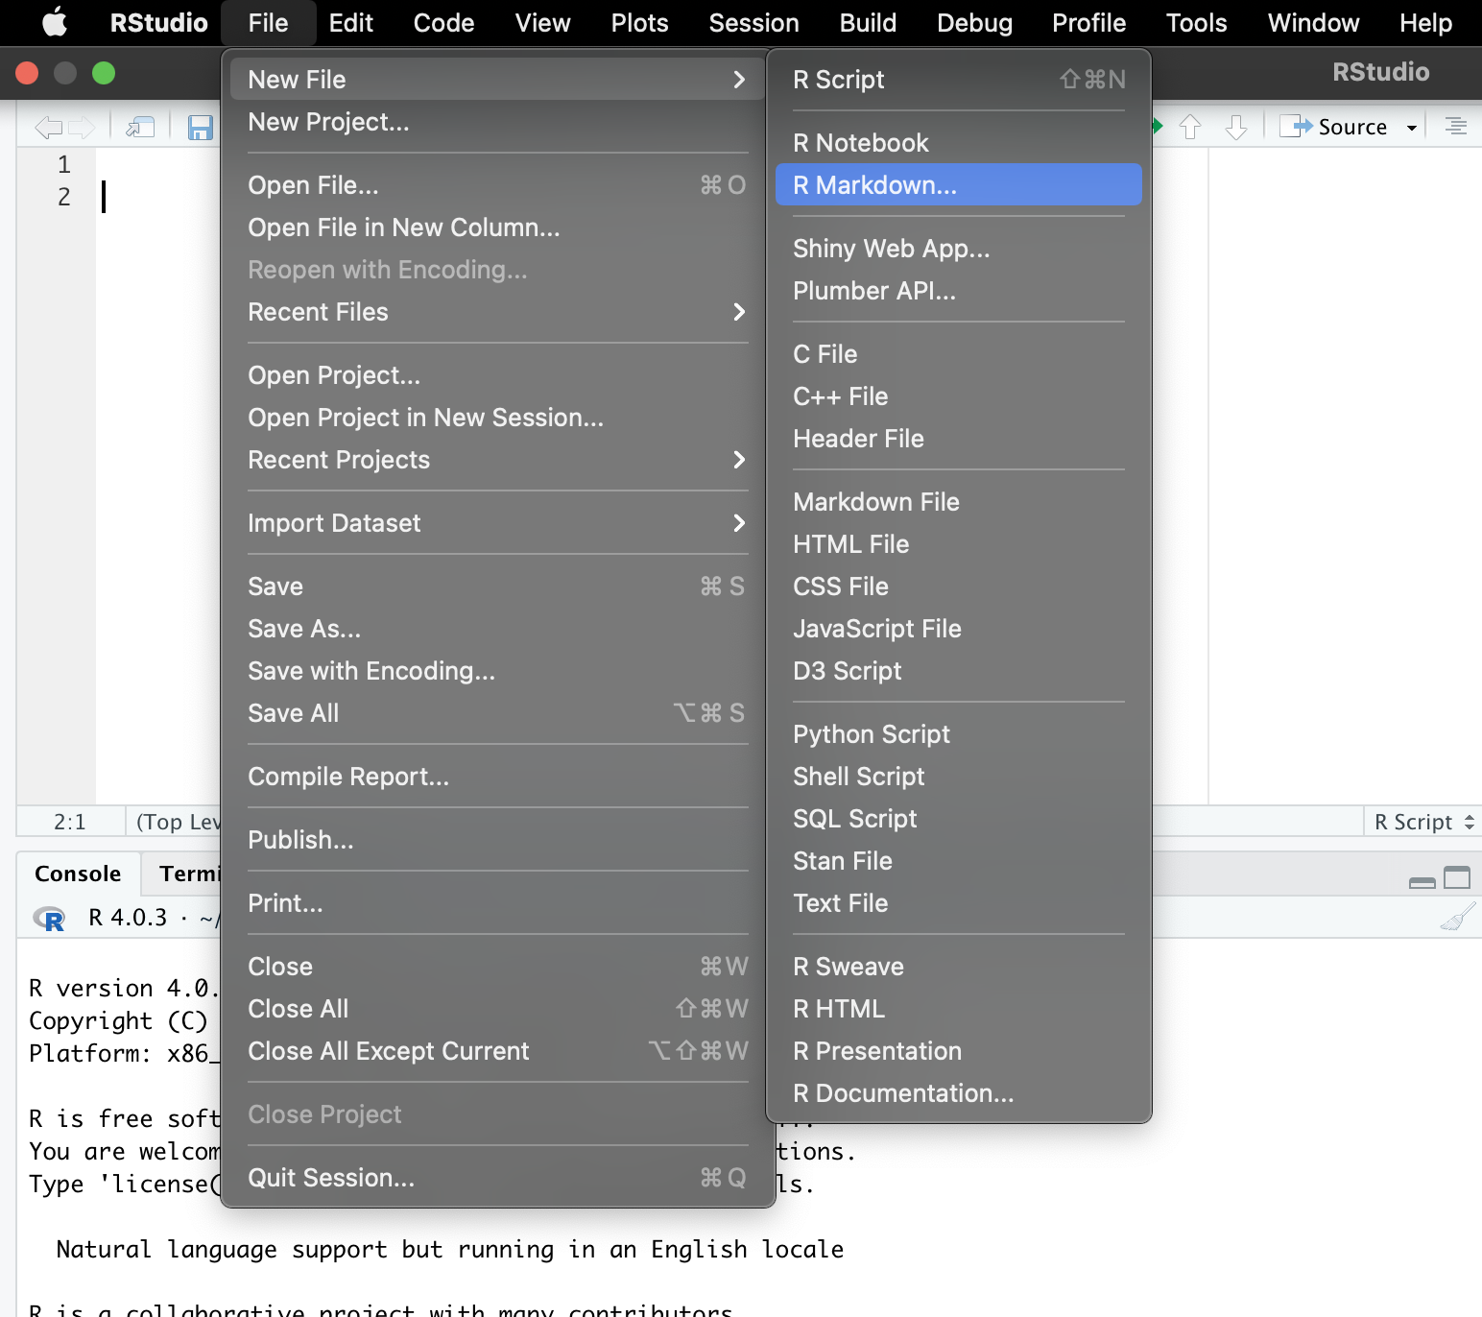
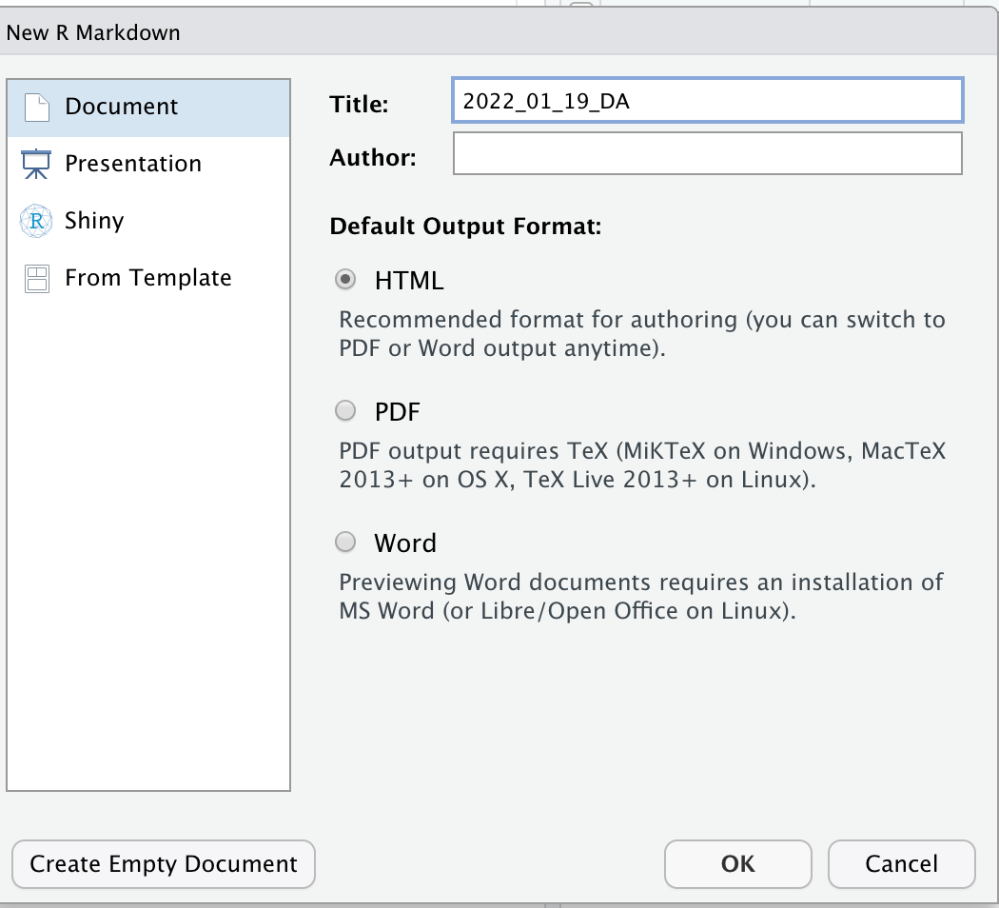
Setting up your RMD
Notes:
To open a new RMD, go to file > New File > and click R markdown. Then name it however you like, choose the output format (usually html) and click ok

Slide 15
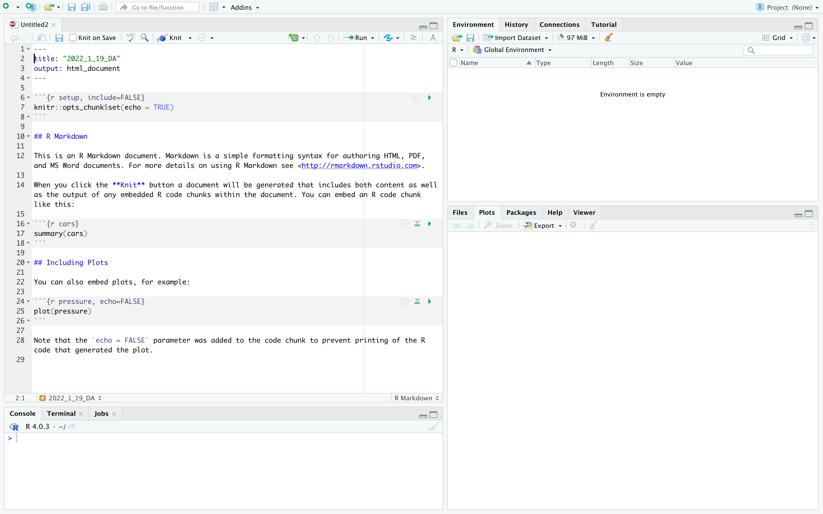
Setting up your RMD
Notes:
When you open an RMD file, you will see a template that is pre-loaded. We can edit this according to our needs.

Slide 16
Components of an RMD
Metadata (YAML)
Text (Markdown)
Code ( R )
Notes:
There are three main components for an RMD. The metadata is written in YAML syntax and we can specify options for the output document here such as CSS code. Below this is the text. This is where we can write about the code and the analysis and the syntax is markdown. The text is interspersed with code using what we call code chunks. If you write you code outside of these code chunks, they don’t get executed.
To insert code chunk we click on the +C button. You can execute an entire code chunk at one by clicking the green button
Try knitting this file by clicking on the Knit button to get an idea for how this works

Slide 17
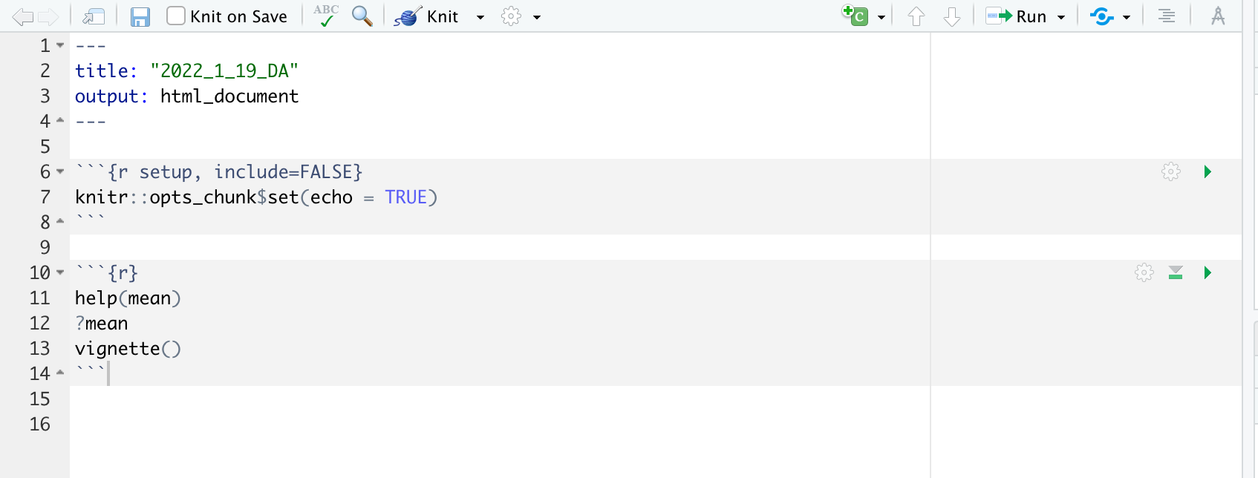
Getting help - within R studio
Help command
R studio has two ways to pull documentation of a function
help(name_of_the_function)
help(mean)
?name_of_the_function
?mean
Vignettes
Vignettes are how-to guides with examples
vignette( ) - to get a list of all available vignettes in your R studio
browseVignettes( ) – to see the vignettes for a specific package (if available)

Slide 18
What are packages and functions in R?
Base R
built in functions in R
Packages extend the functionality of R
Users package libraries of functions they developed and make it available
Functions let us do very specific types of analyses
Packages need installation
install.packages()
loading libraries (attach it to your session)
library()
Notes:
When we install R studio it comes with some built in functions of R and these are referred to as base R functions

Slide 19
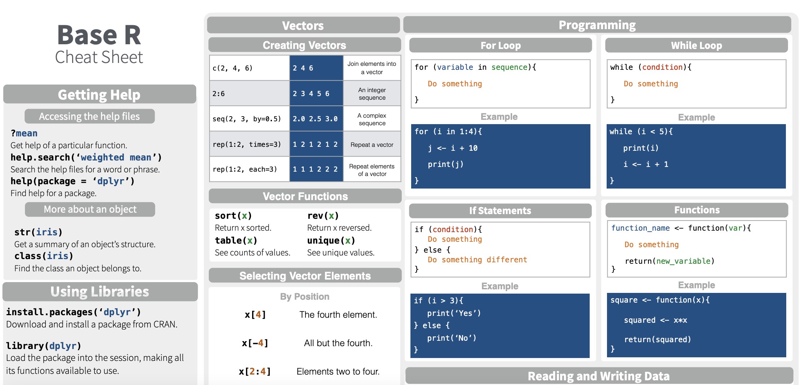
Base R cheatsheet
https://iqss.github.io/dss-workshops/R/Rintro/base-r-cheat-sheet.pdf
Notes:
When we install R studio it comes with some built in functions of R and these are referred to as base R functions

Slide 20
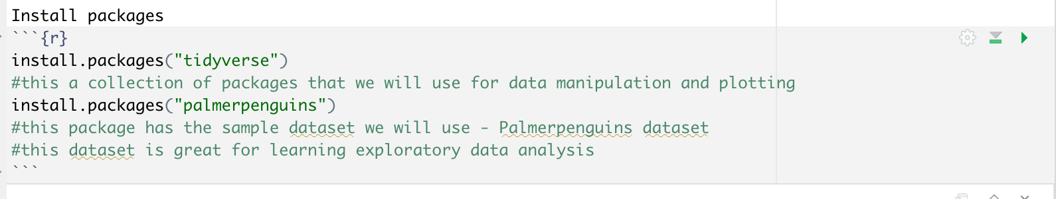
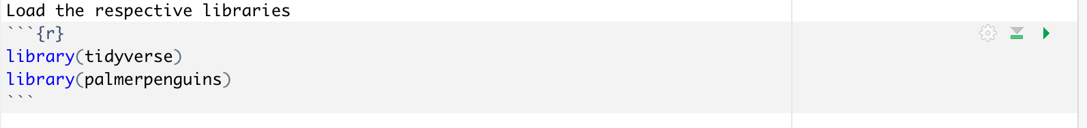
Installing packages

Slide 21
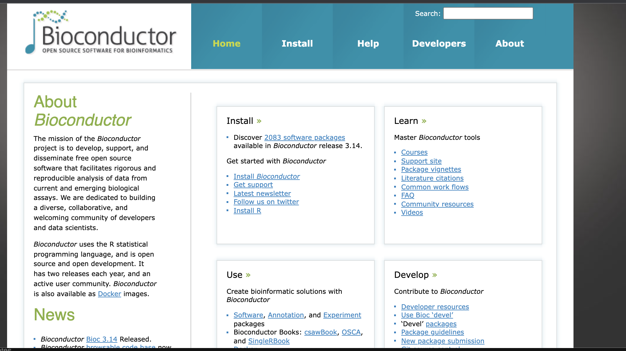
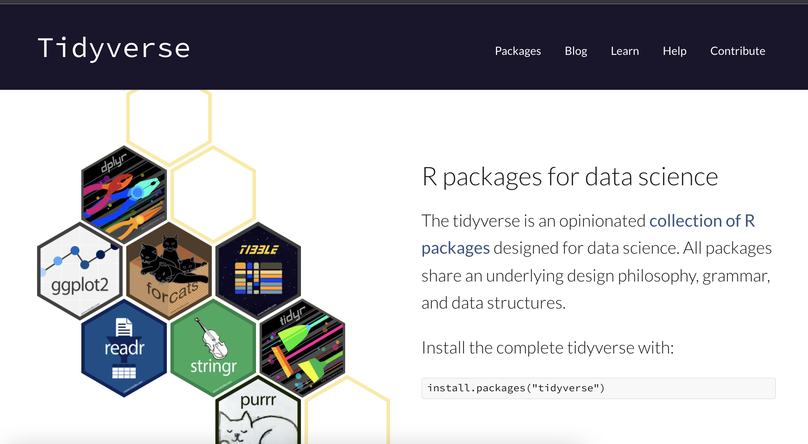
CRAN, Tidyverse, Bioconductor,
Comprehensive R archive network (CRAN)
Main repository for R packages
Bioconductor
Repository for packages develop in R for bioinformatics analysis
Bioconductor (Version 3.6) consists of 1477 software packages
Tidyverse
Collection of open-source packages Developed by Hadley Wickham
Encourage piping
Notes:
General overview of the repositories or collections from where we install packages. There are three main ones that you might come across – CRAN, Bioconductor and R. CRAN is the main repository. More specialized ones evolved. Bioconductor was developed more recently but is growing rapidly
Tidyverse is mainly for datascience – the code for the functions is not nested like in base R but use the pipe function- this improves the functionality.

Slide 22
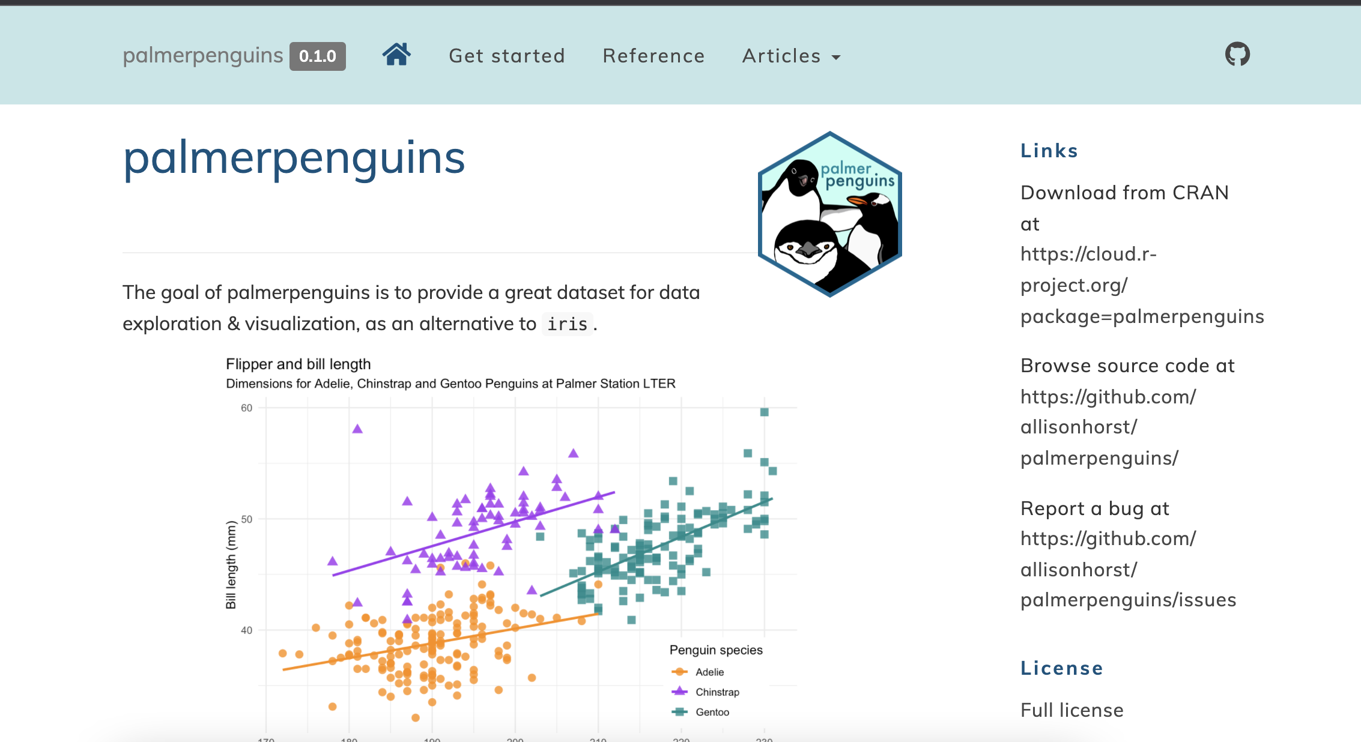
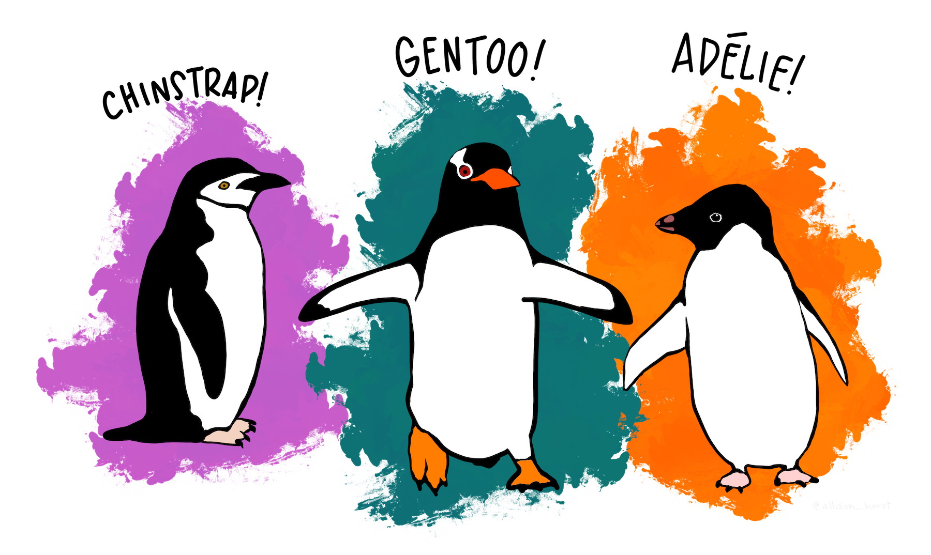
Palmerpenguins
Developed by Allison Horst
Great dataset for data exploration and visualization
Data for 344 penguins of 3 different species of penguins collected from 3 islands
Data available
Bill length, bill depth, flipper length, body mass
Sex
Year
The palmerspenguins package has two datasets
penguins – simplified version of the raw data
penguins_raw – raw dataset as downloaded
“Artwork by @allison_horst”.

Slide 23
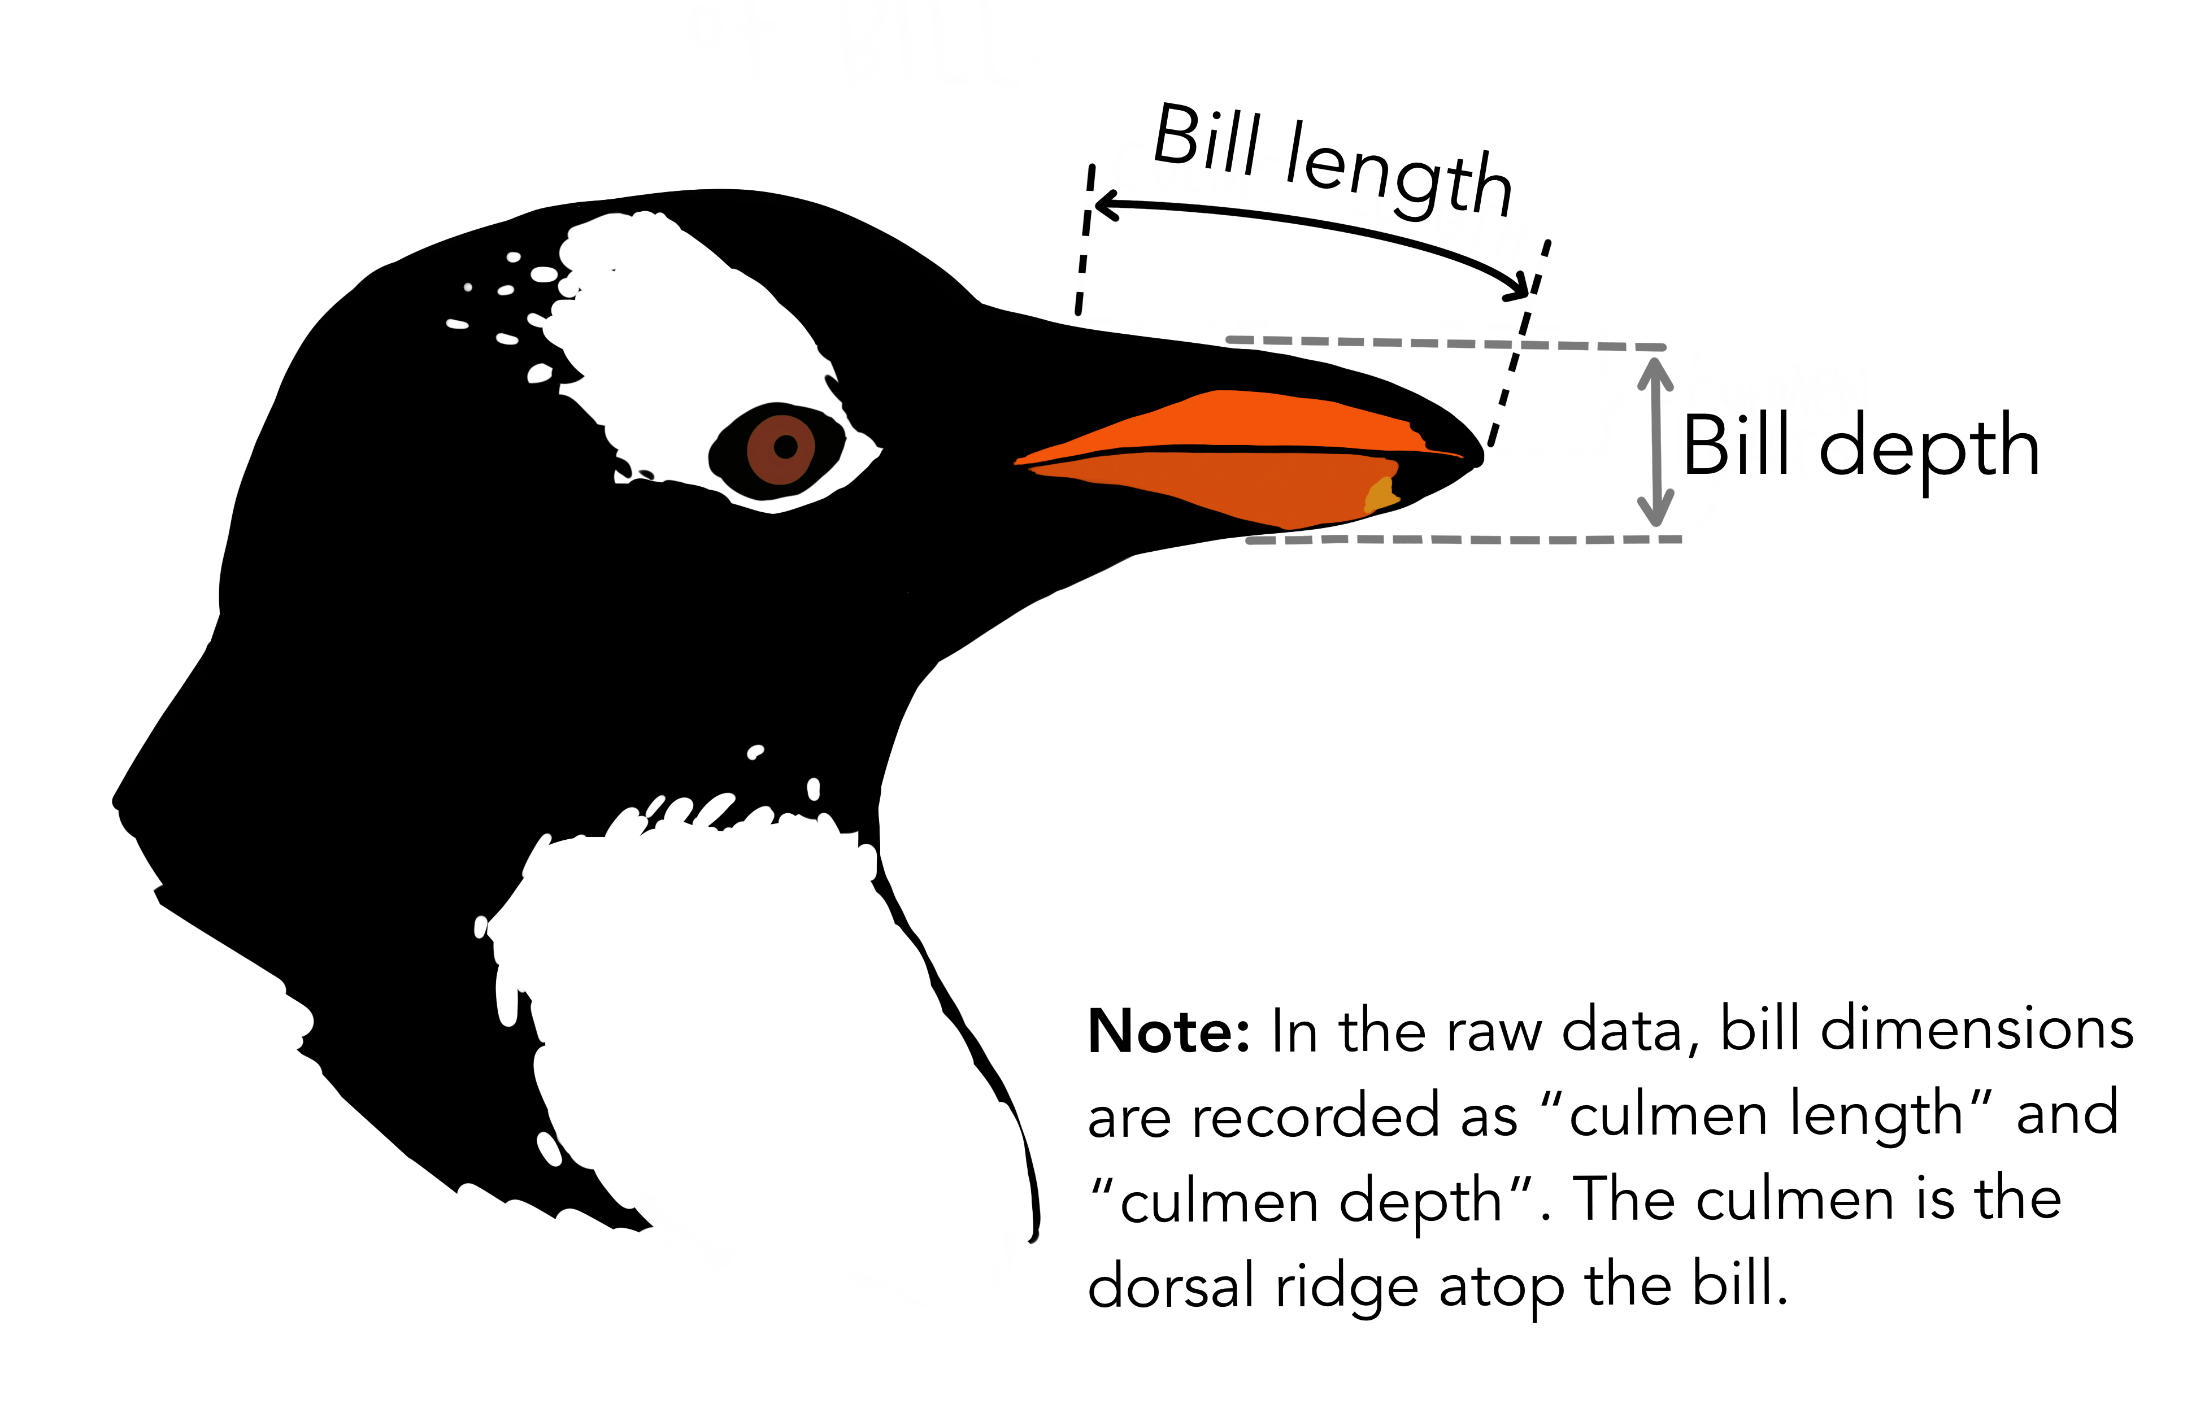
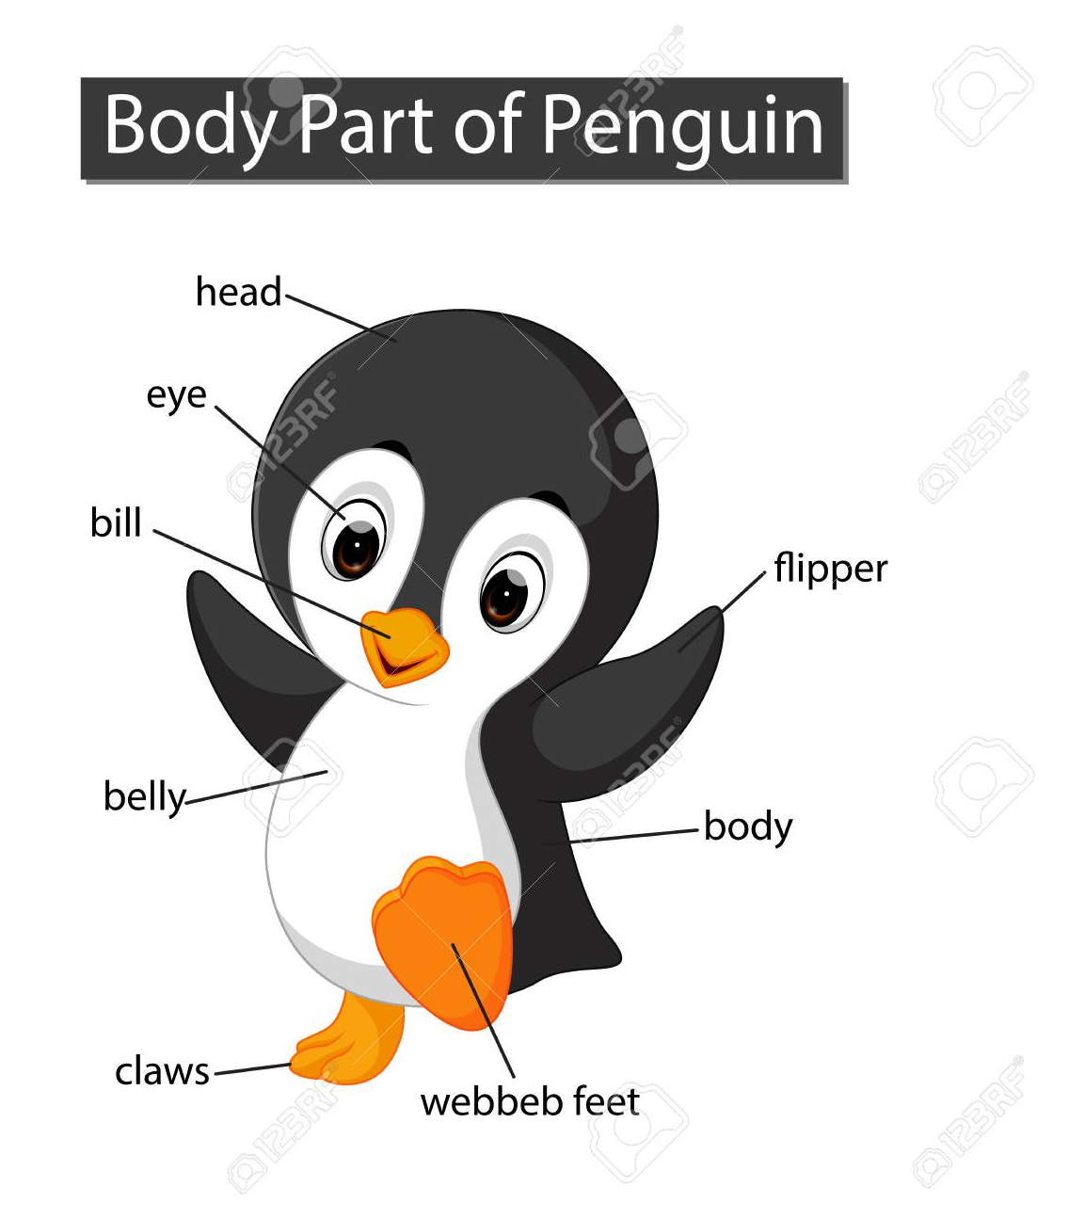
https://www.kaggle.com/parulpandey/penguin-dataset-the-new-iris
https://allisonhorst.github.io/palmerpenguins/
Notes:
In case you are wondering what the different measurements in the data set mean

Slide 24
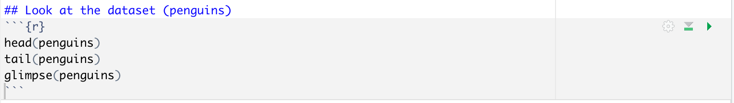
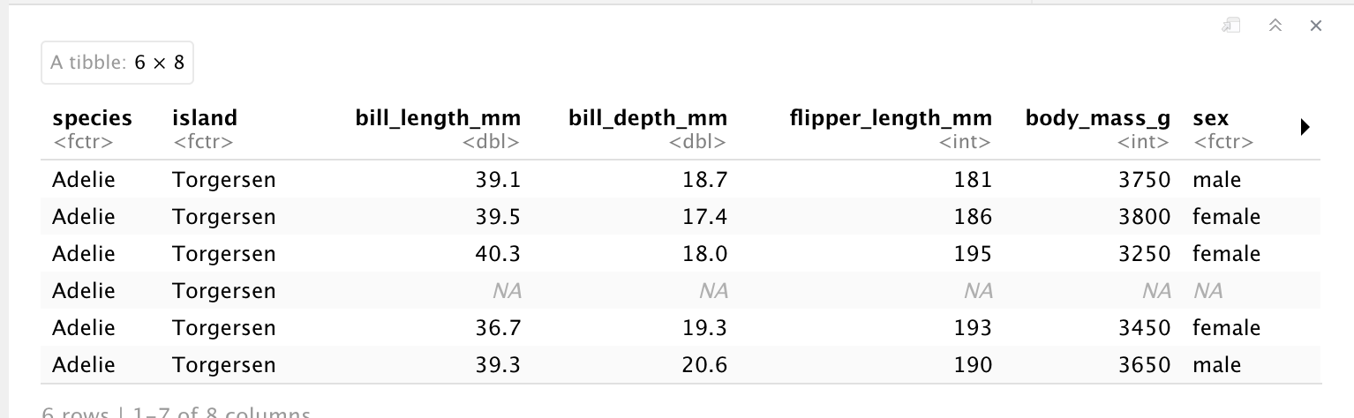
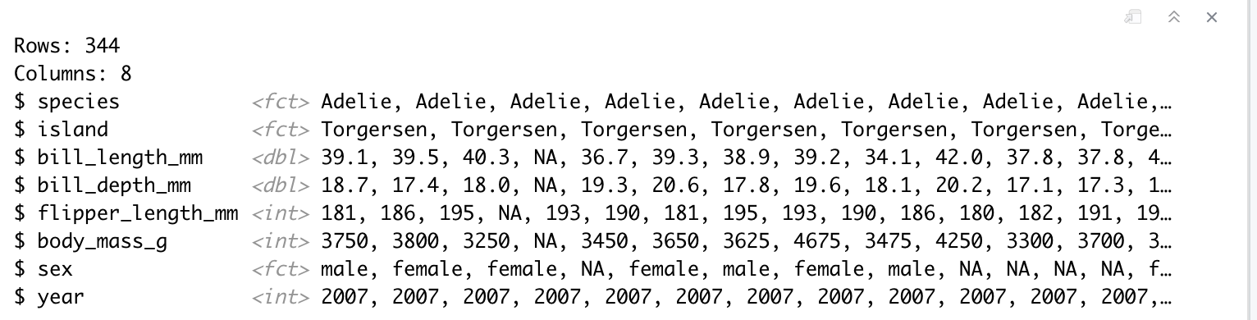
Exploratory analysis
Notes:
Use these functions to look at the top and bottom few lines from the dataset

Slide 25
Objects in R
The different kinds of data we work with in R are called objects
There are 6 types of objects
Vector
List
Matrix
Array
Factor
Data frame

Slide 26
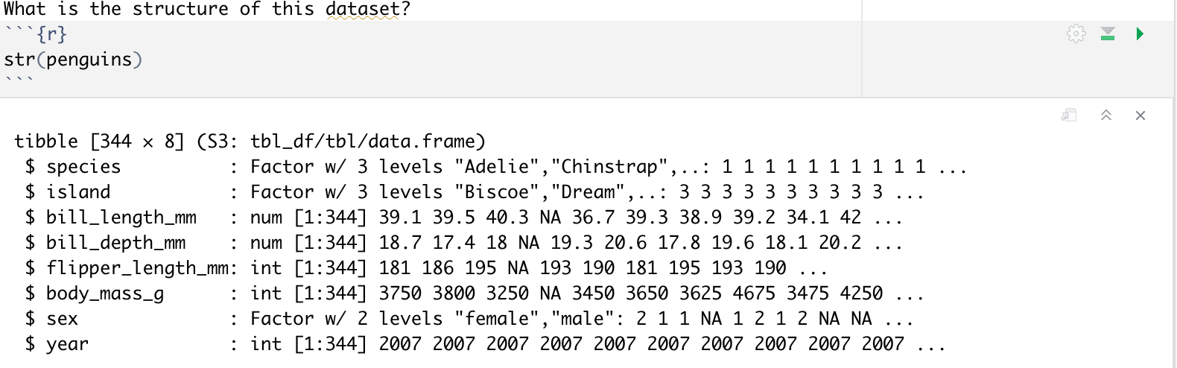
Exploratory analysis
str( )
Used to understand the data structure
Notes:
Tibble is a type of dataframe

Slide 27
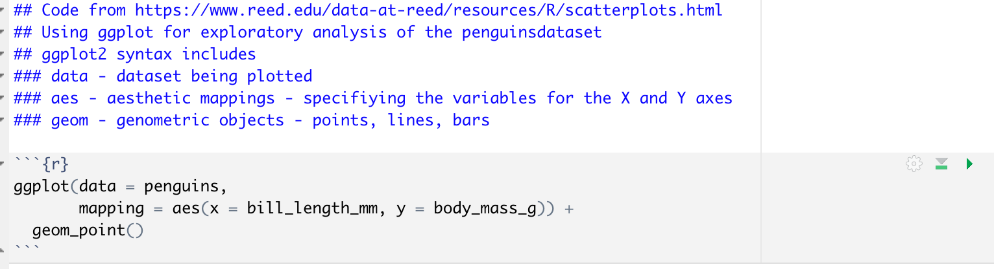
Exploratory analysis – scatterplot with ggplot2
Question – How does the bill length change with body mass?

Slide 28
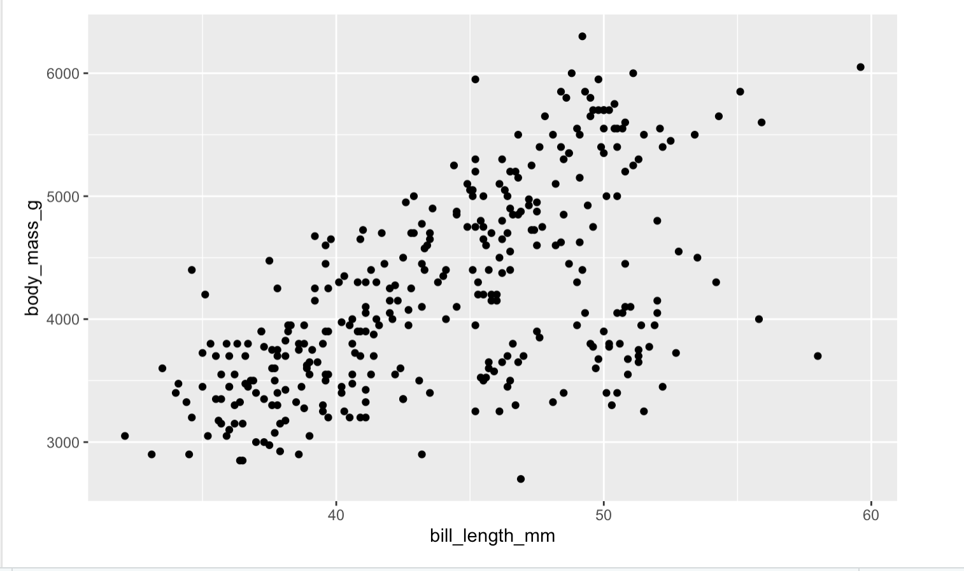
Exploratory analysis – scatterplot with ggplot2
Question – How does the bill length change with body mass?

Slide 29
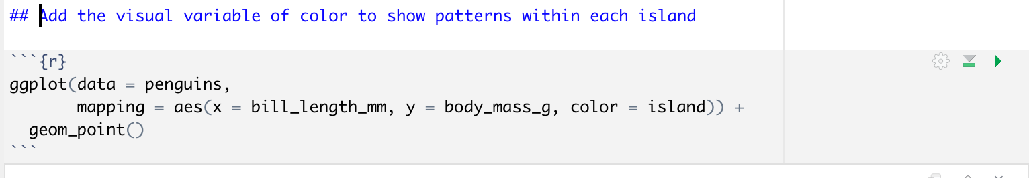
Exploratory analysis – scatterplot with ggplot2
Question – How does the bill length change with body mass?

Slide 30
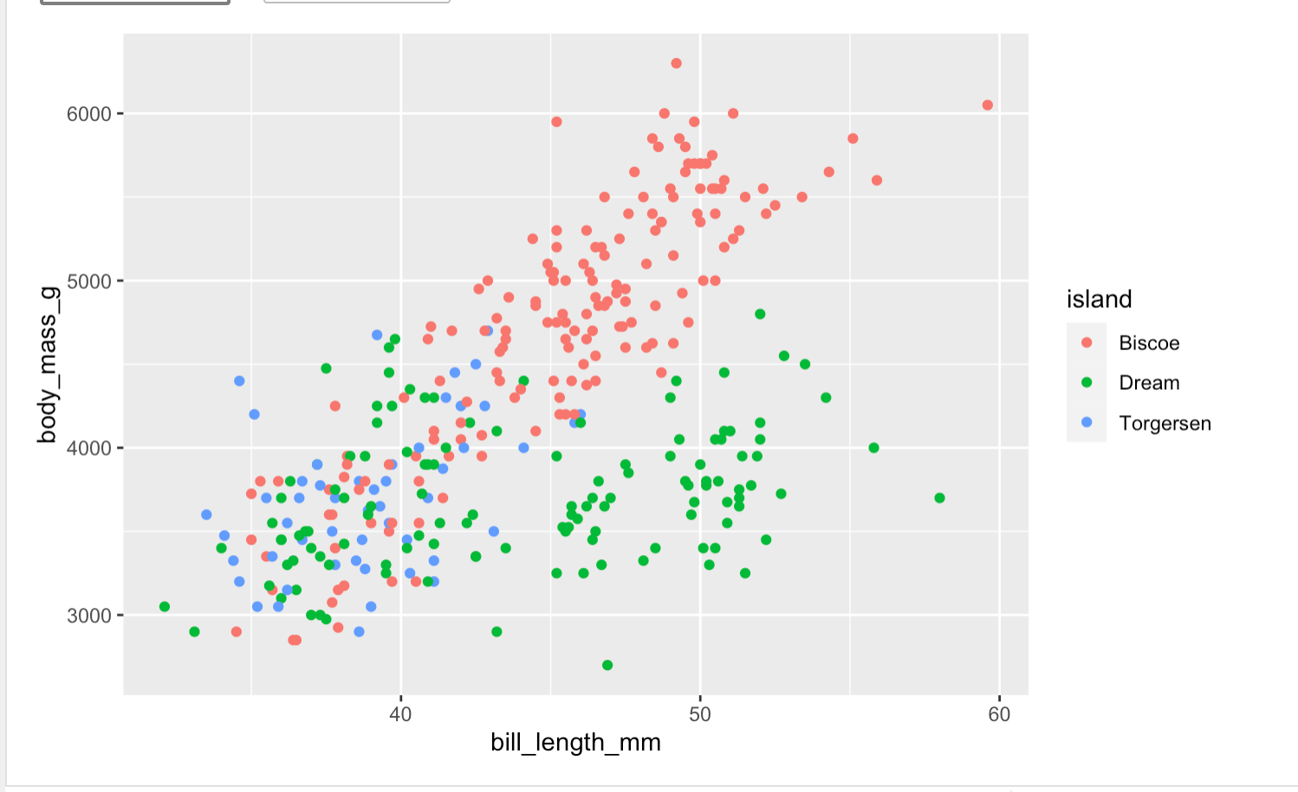
Exploratory analysis – scatterplot with ggplot2
Question – How does the bill length change with body mass?

Slide 31
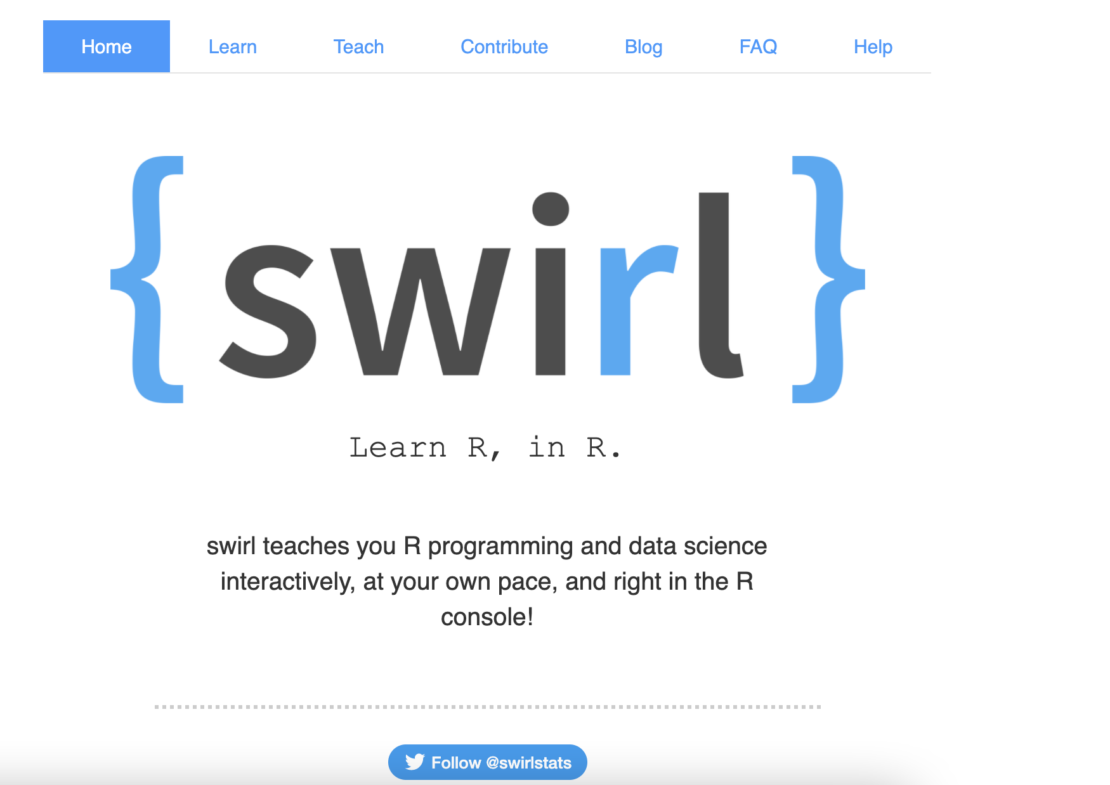
Learning resource – swirl
Great way to get hands on experience with R with their interactive courses
Notes:
Swirl is a package that you install in R studio and you would be able to learn through their different interactive courses

Slide 32
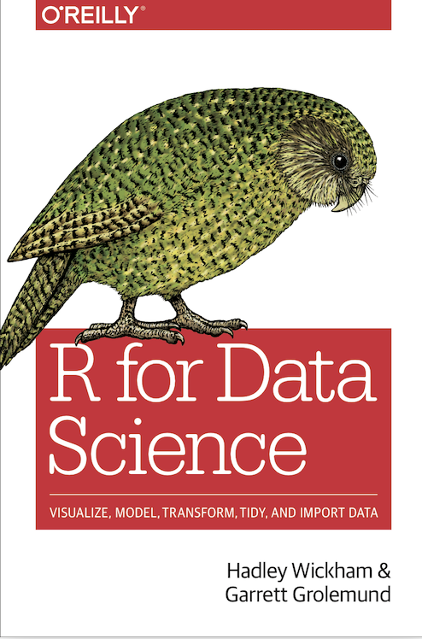
Getting help – outside R studio
Books
R for Data science - Hadley Wickham and Garrett Grolemund
Websites
R documentation - Data camp - documentation on CRAN and Bioconductor packages
Stackoverflow - troubleshooting

Slide 33
References
Introduction to R – library carpentry
R markdown - a definitive guide
R markdown cheat sheet
Base R cheat sheet
Tidyverse
Palmer penguins dataset
Reed college – analysis using palmerpenguins dataset

